Slide 1
Software Security

Slide 2
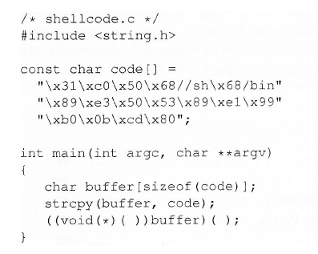
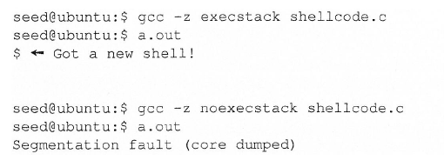
Return-to-Libc Attack

Slide 3
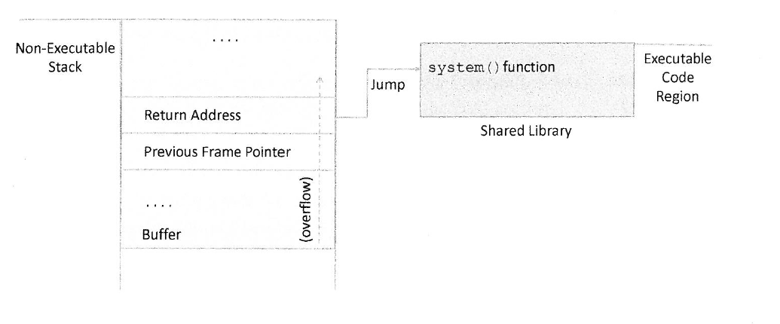
Idea

Slide 4
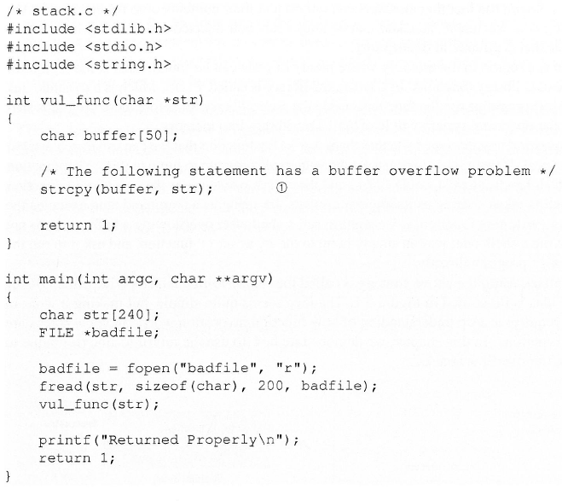
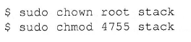
Environment

Slide 5
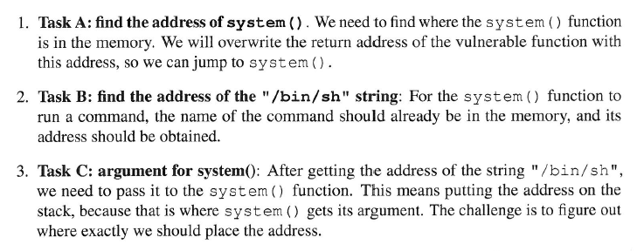
Tasks

Slide 6
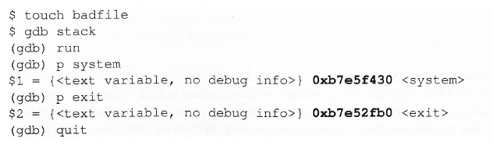
Finding Address of system() and exit()

Slide 7
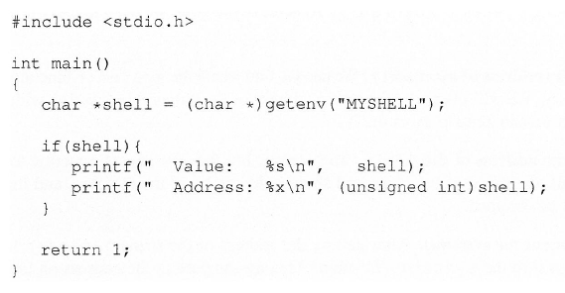
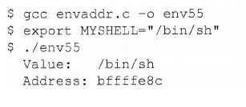
Finding Address of string “\bin\sh”

Slide 8
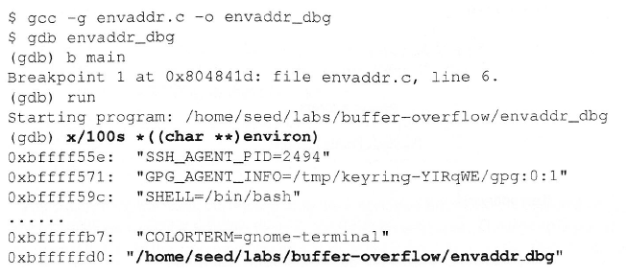
Caution : Filename length

Slide 9
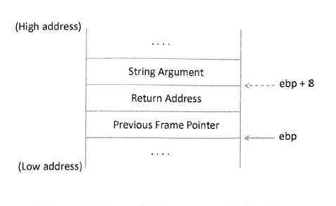
Stack Frame

Slide 10
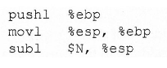
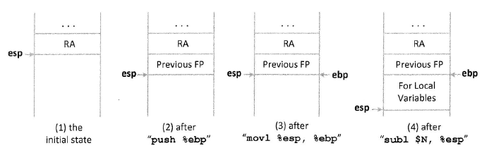
Function Prologue

Slide 11
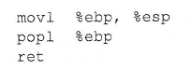
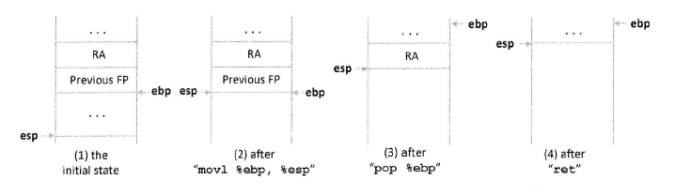
Function Epilogue

Slide 12
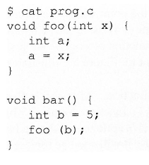
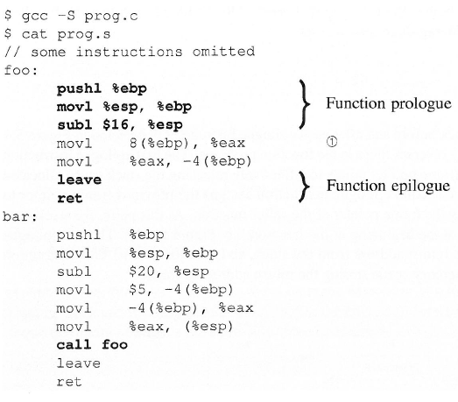
Example

Slide 13
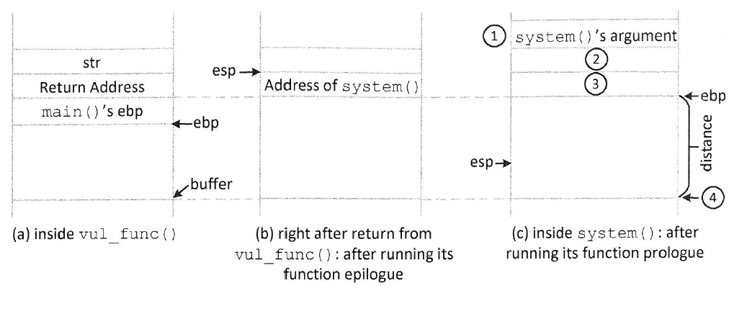
Launching the Attack

Slide 14
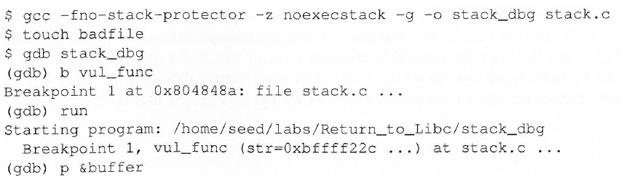
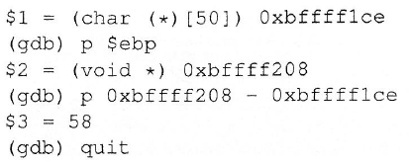
Launching the Attack

Slide 15
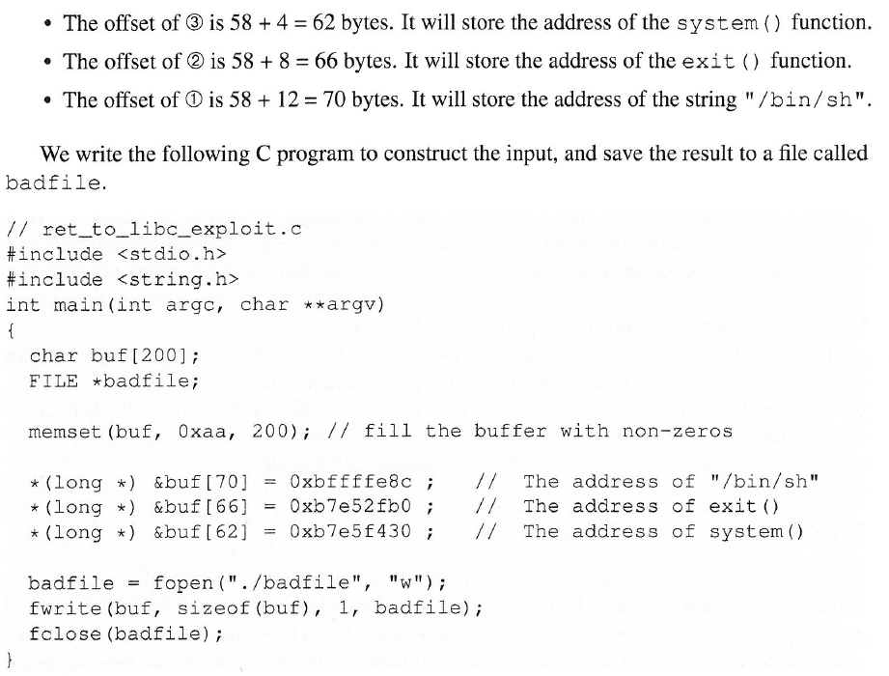

Slide 16
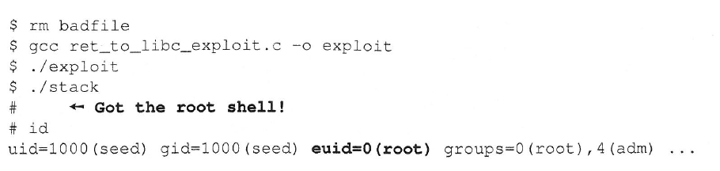
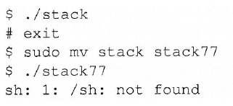
Launching the Attack

Slide 17
Race Condition Vulnerability

Slide 18
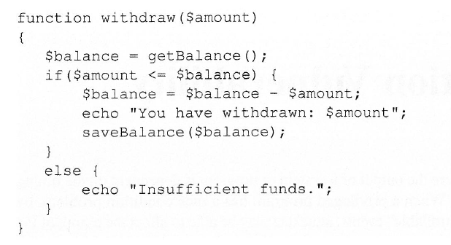
Race Condition Vulnerability
Race conditions in software occurs when two concurrent threads of executions occur in a way that unintentionally produces different results depending on the timing of the processes or threads

Slide 19
Time-of-Check Time-of-Use (TOCTOU)
Special type of race condition in software
Occurs when checking a condition before using a resource
Condition may change between time-of-check and time-of-use

Slide 20
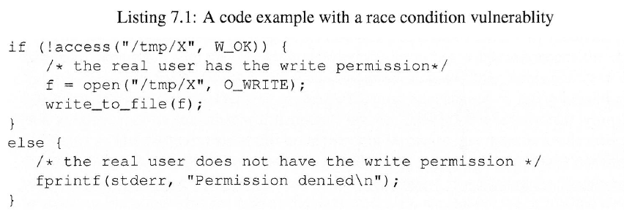
Example Vulnerable Program
Race condition can be achieved using symlink – a special kind of file that points to another file

Slide 21
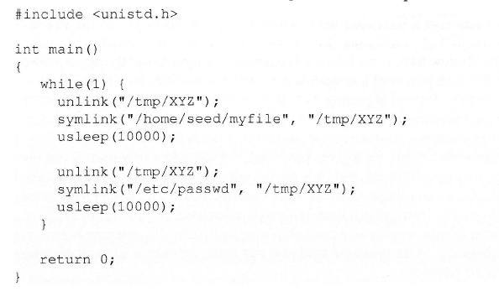
Attacker Code Sample

Slide 22
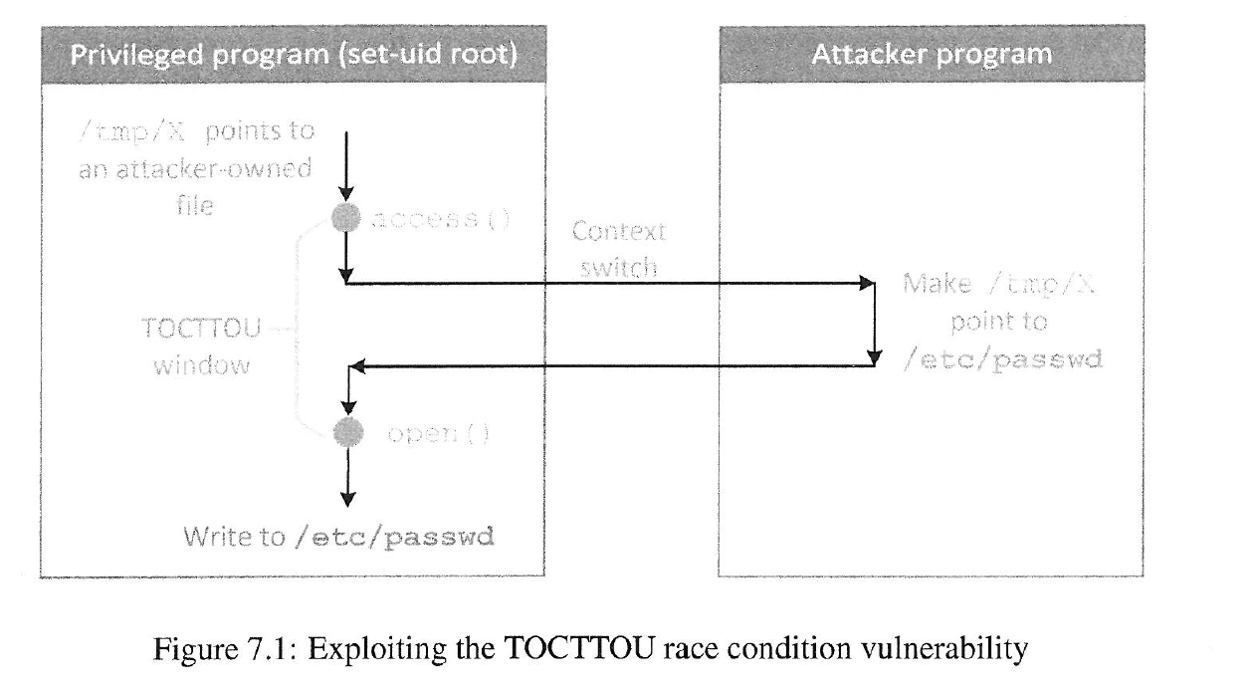

Slide 23
Race Condition Vulnerability
If we change symlink too early – access() will fail
Too late : file already opened
Change has to be made in the TOC and TOU window
If we try enough times – we may get lucky!
And all we need is to succeed once!

Slide 24
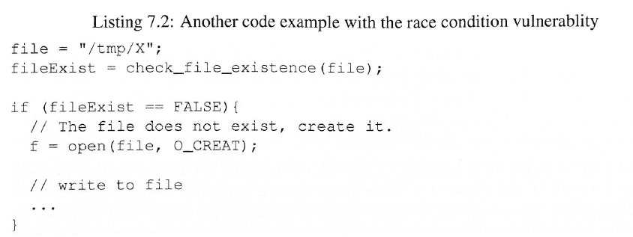
Another Example

Slide 25
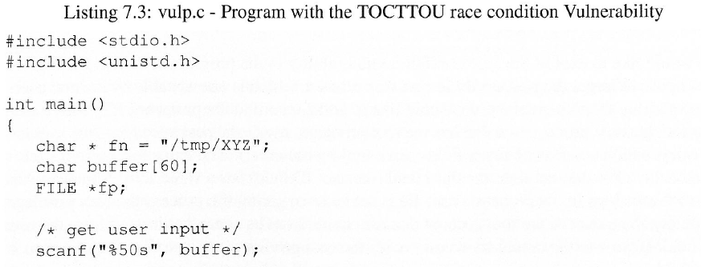
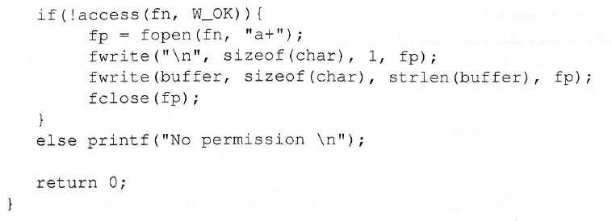

Slide 26
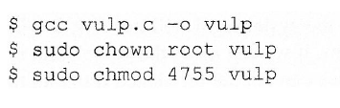
Setup

Slide 27
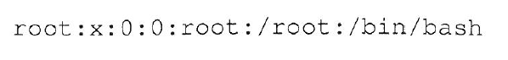
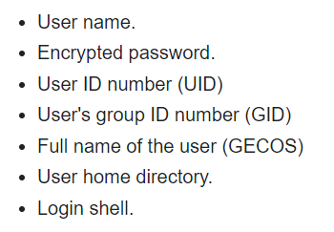
Target File : /etc/password

Slide 28
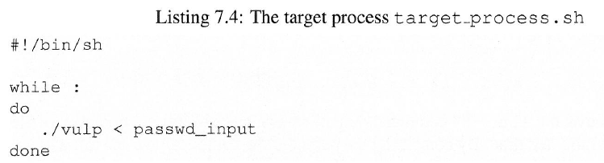
The Target Process
We need to create two processes that “race” against each other.
Target process : runs the privileged program
Attack process : Our program designed to launch the attack
Run the vulnerable program in an infinite loop
Take input the string we want to put in /etc/password

Slide 29
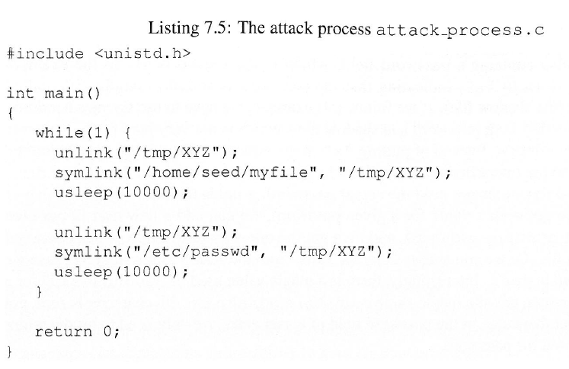
The Attack Process

Slide 30
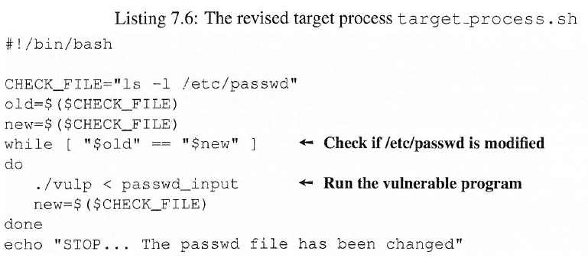
Monitor The Result

Slide 31
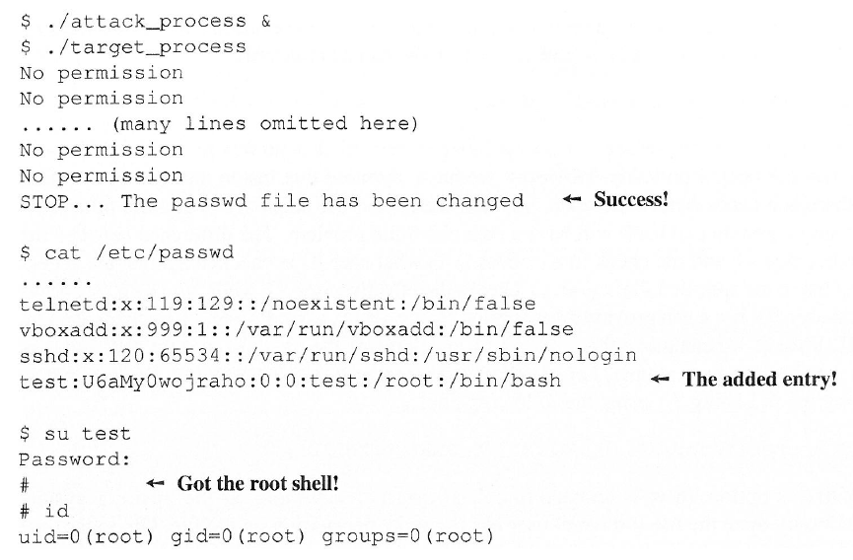
Running the Exploit

Slide 32
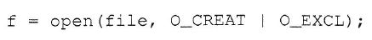
Countermeasures
Atomic Operation
Completely eliminate the window between TOC and TOU by making checking and usage atomic
Need support at the OS level

Slide 33
Countermeasures
Repeating check and use
Attacker has to win many race conditions at once
Makes the program relatively safer

Slide 34
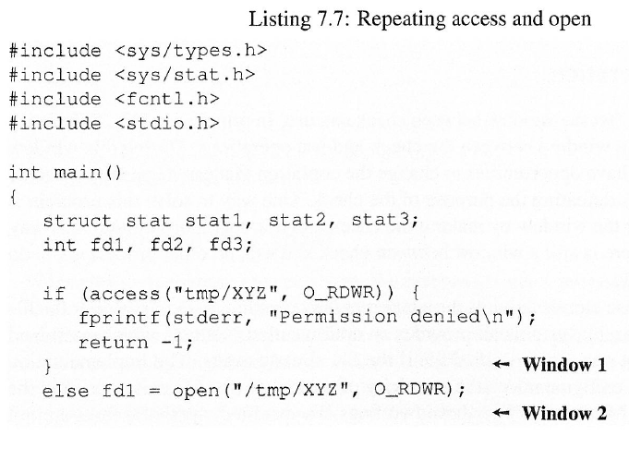
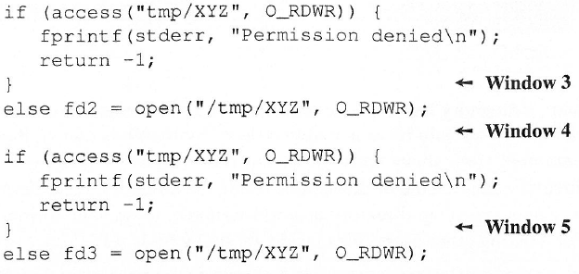
Countermeasures

Slide 35
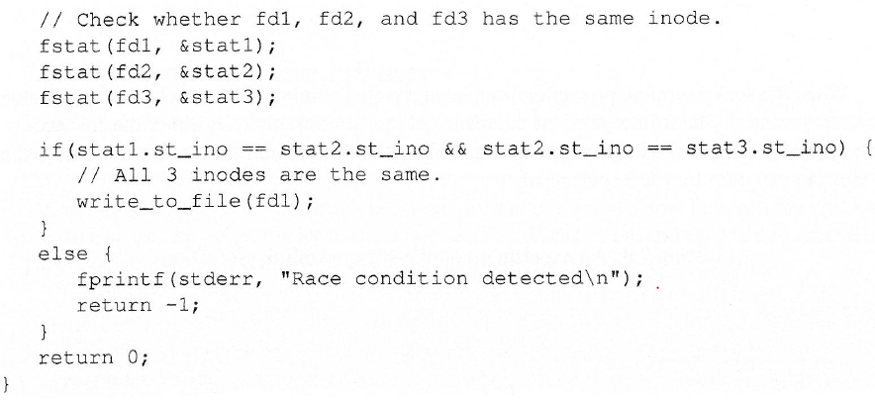

Slide 36
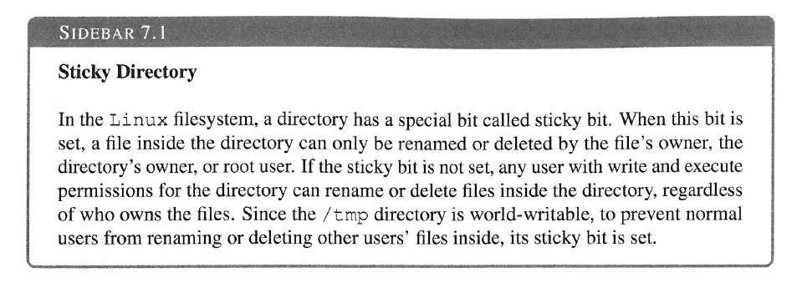
Countermeasures
Sticky symlink protection
Prevents programs from following symlinks under certain conditions

Slide 37
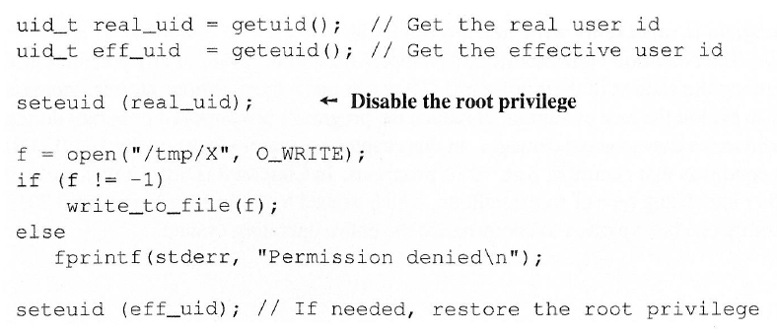
Countermeasures
Principle of least privilege
Program should not run in a higher privilege than what is needed

Slide 38
Format String Vulnerability

Slide 39
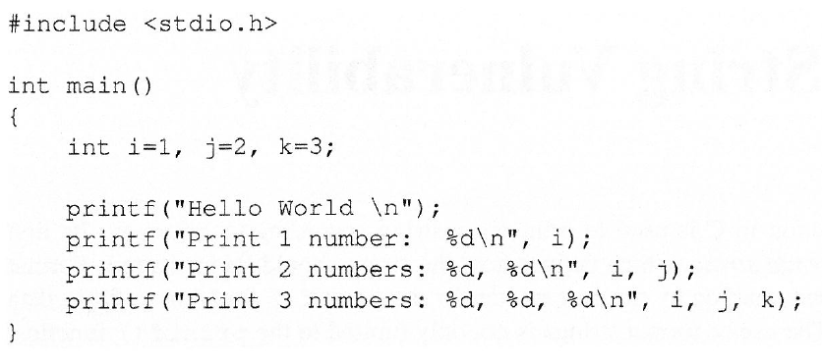
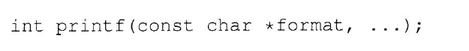
Functions with variable no. of Arguments

Slide 40
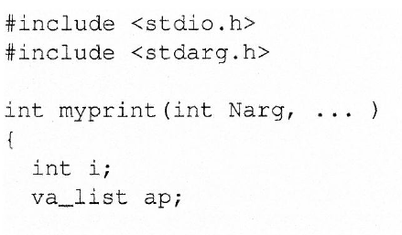
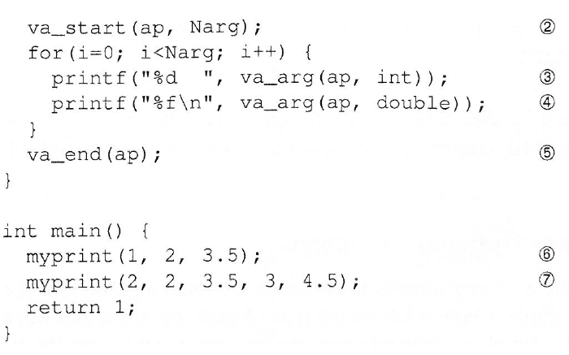

Slide 41
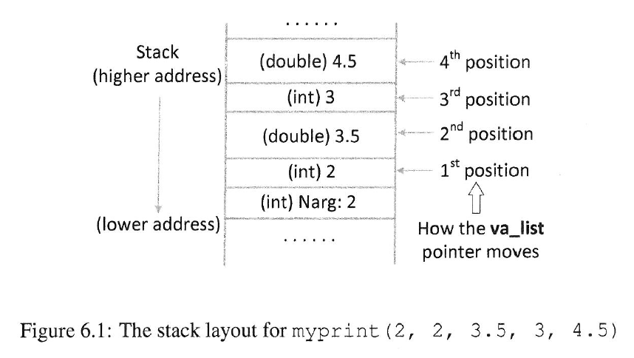

Slide 42
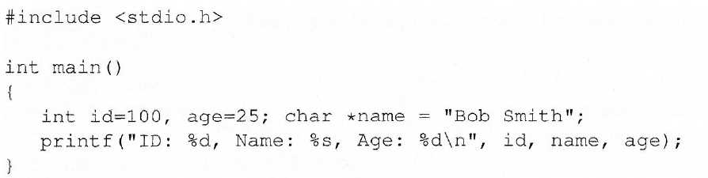
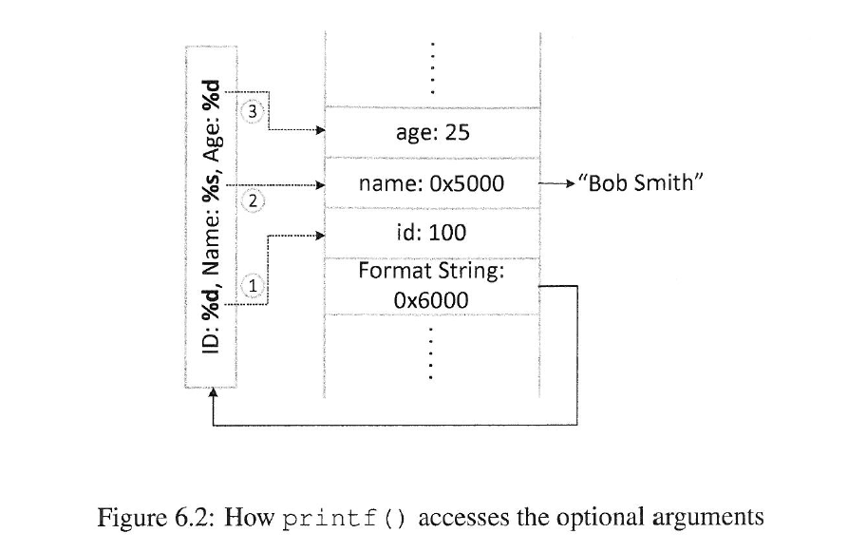

Slide 43



Slide 44

When Missing Argument Can Be Dangerous

Slide 45

Example Vulnerable Program

Slide 46

Vulnerable Progam Stack Layout

Slide 47

Crash The Program

Slide 48

Print Out Data On the Stack

Slide 49

Change Program’s Data in Memory

Slide 50
References
Computer Security (A Hands on Approach) – Wenliang Du (Syracuse University)
Chapter 5, 6, 7

